Slide 1


AUTOMATED BUS CROWD MANAGEMENT SYSTEM
East Point College Of Engineering And Technology
Department Of Information Science And Engineering
Presented By,
Mr. Jerrin Joy
Mr. Kruthik Gandhi H A
Mr. Manish G
1EP18IS032
1EP18IS038
1EP18IS043
Under The Guidance Of,
Dr. Udayabalan Balasingam
Dept. Of ISE, EPCET.

Slide 2


ABSTRACT
The Embedded Technology is now in its prime and the wealth of Knowledge available is mind- blowing. Embedded technology plays a major role in integrating the various functions associated with it. This needs to tie up the various sources of the Department in a closed loop system. This proposal greatly reduces the manpower, saves time and operates efficiently without human interference. This project puts forth the first step in achieving the desired target. With the advent in technology, the existing systems are developed to have in built intelligence. Now a days we come across theft, terrorist attacks on public transportation systems. Many a time it becomes difficult for investigating agencies to track the cases. We are proposing a Centralized bus control system where a passenger needs to fill up the details by submitting required ID & address proof as per Know your Passenger policy and purchase a unique ID Bus pass card having unique number (RFID Tag).

Slide 3

PROBLEM STATEMENT
In traditional paper based ticketing, everyday tickets are being printed and sealed with the date manually by the bus conductor travelling in the bus. After finish travelling, the passengers usually throw away the used paper made tickets here & there which ultimately pollutes the environment. Trees are being cut as to make papers and the current system uses the paper based ticketing. Our proposed system uses the RFID tagged card carried out by the passengers and does everything automatically and eventually reduces the complexities faced by the commuters. Some benefits of RFID based ticketing framework over conventional system (both paper based tickets & magnetic tickets) .

Slide 4



EXISTING SYSTEM
The existing systems determines only the density of the crowd in the bus.
• In the existing system, the bus tickets are provided by the bus conductor and monitoring the traffic and bus routes are done.
• Information about the location of the bus is sent to the bus information server. The location of the bus is monitored and the location will be viewed on our mobile and also the crowd level can be detected to avoid bus crowds.
• The disadvantages of the existing system are possibility of over fare on ticket charges, the system is applicable only for comfort journey, not for secured journey, the exact count of passenger in the bus is not
provided and advanced accident alert system is absent.
• Using webcam for crowd management is not a good option and it is less efficient.

Slide 5

PROPOSED SYSTEM
Users can scan the QR code instead of the paper tickets. The passengers are provided with an android app where they register their details by providing their mobile number, email id, user-name, and password.
After registration, the users can log in with the id and password provided while registration. The next step will be adding the money to the wallet and it can be done by usual bank transaction by entering bank details manually.
In the next process, the user has to enter the from and to address. By doing this the app will automatically generate the number of buses running on that particular route along with the amount details per head.
Then comes the number of passengers to be traveled during that particular journey, enter the details and select next. Now it will generate the total amount that will be deducted from our wallet but before the amount will be deducted the passengers will have to scan the QR code that will be inside the bus with the conductor or in the entrance of the bus door.

Slide 6
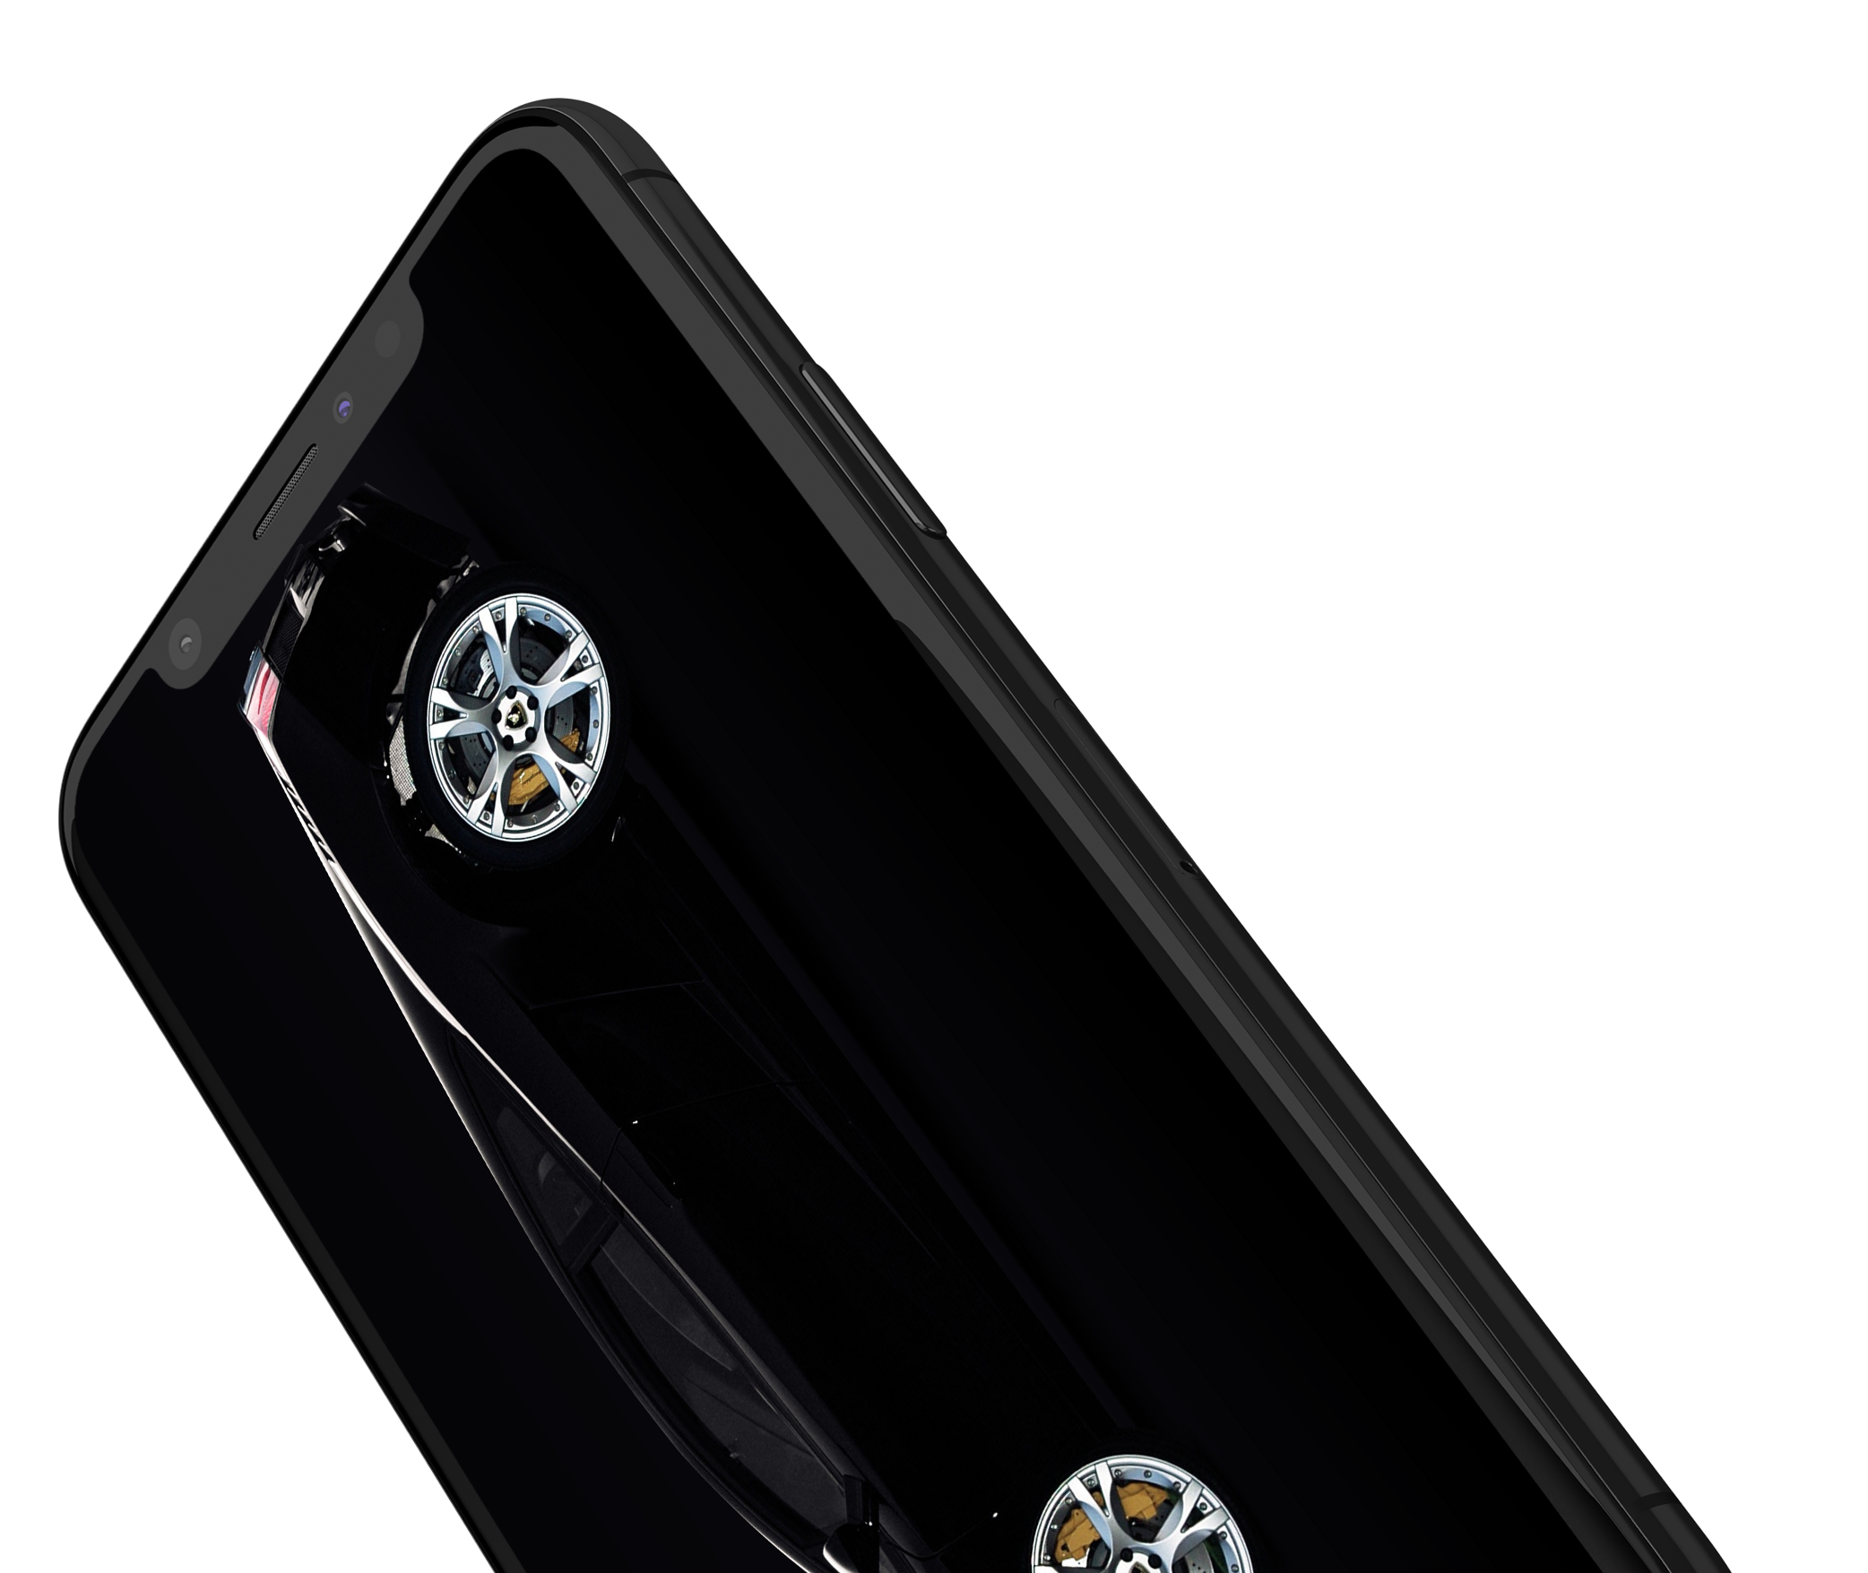
METHODOLOGY
IR sensors are used for detecting the crowd entering and leaving the bus.
Softcopy of the generated ticket will be sent to the user’s pre-registered mobile number, so that no more loss of ticket will occur.
During any accident on the bus, the GPS location is immediately tracked and sent to the nearby hospital.
The overall system can be monitored from the main station.

Slide 7

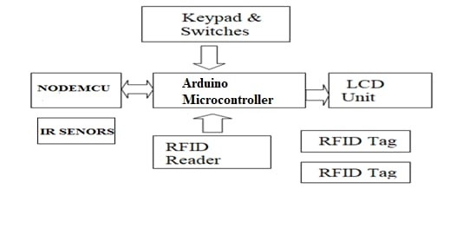
PROPOSED SYSTEM ARCHITECTURE

Slide 8
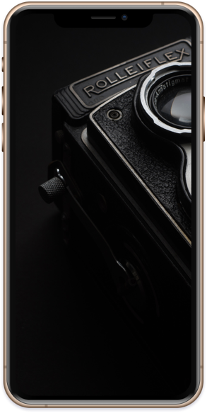

RESULT
This smart bus system enables the passenger to know the available number of seats and space
The bus riders can generate their own tickets using their RFID tags and the softcopy will be generated and sent to the user’s mobile phone
In case of any emergency condition such as accident the GPS location will be sent to the nearby hospitals
By doing little modifications, this same project can be used for any other Transport system

Slide 9

CONCLUSION
By implementing this project proposal we greatly reduces the manpower, saves time and operates efficiently.
This project is helpful in managing the crowd in the bus, if the bus is full it will send a message, Deduct the amount from their smart card according to the How much KM they Travel and Message sending to the after completion of the journey.
These are the major facilities which are included the project so it will helpful to avoid the spreading of the corona virus from one person to other persons.

Slide 10

THANK YOU!

